Slide 1
HOPE for Tomorrow Podcast
How can we use our voices to affect
social or environmental change?

Slide 2
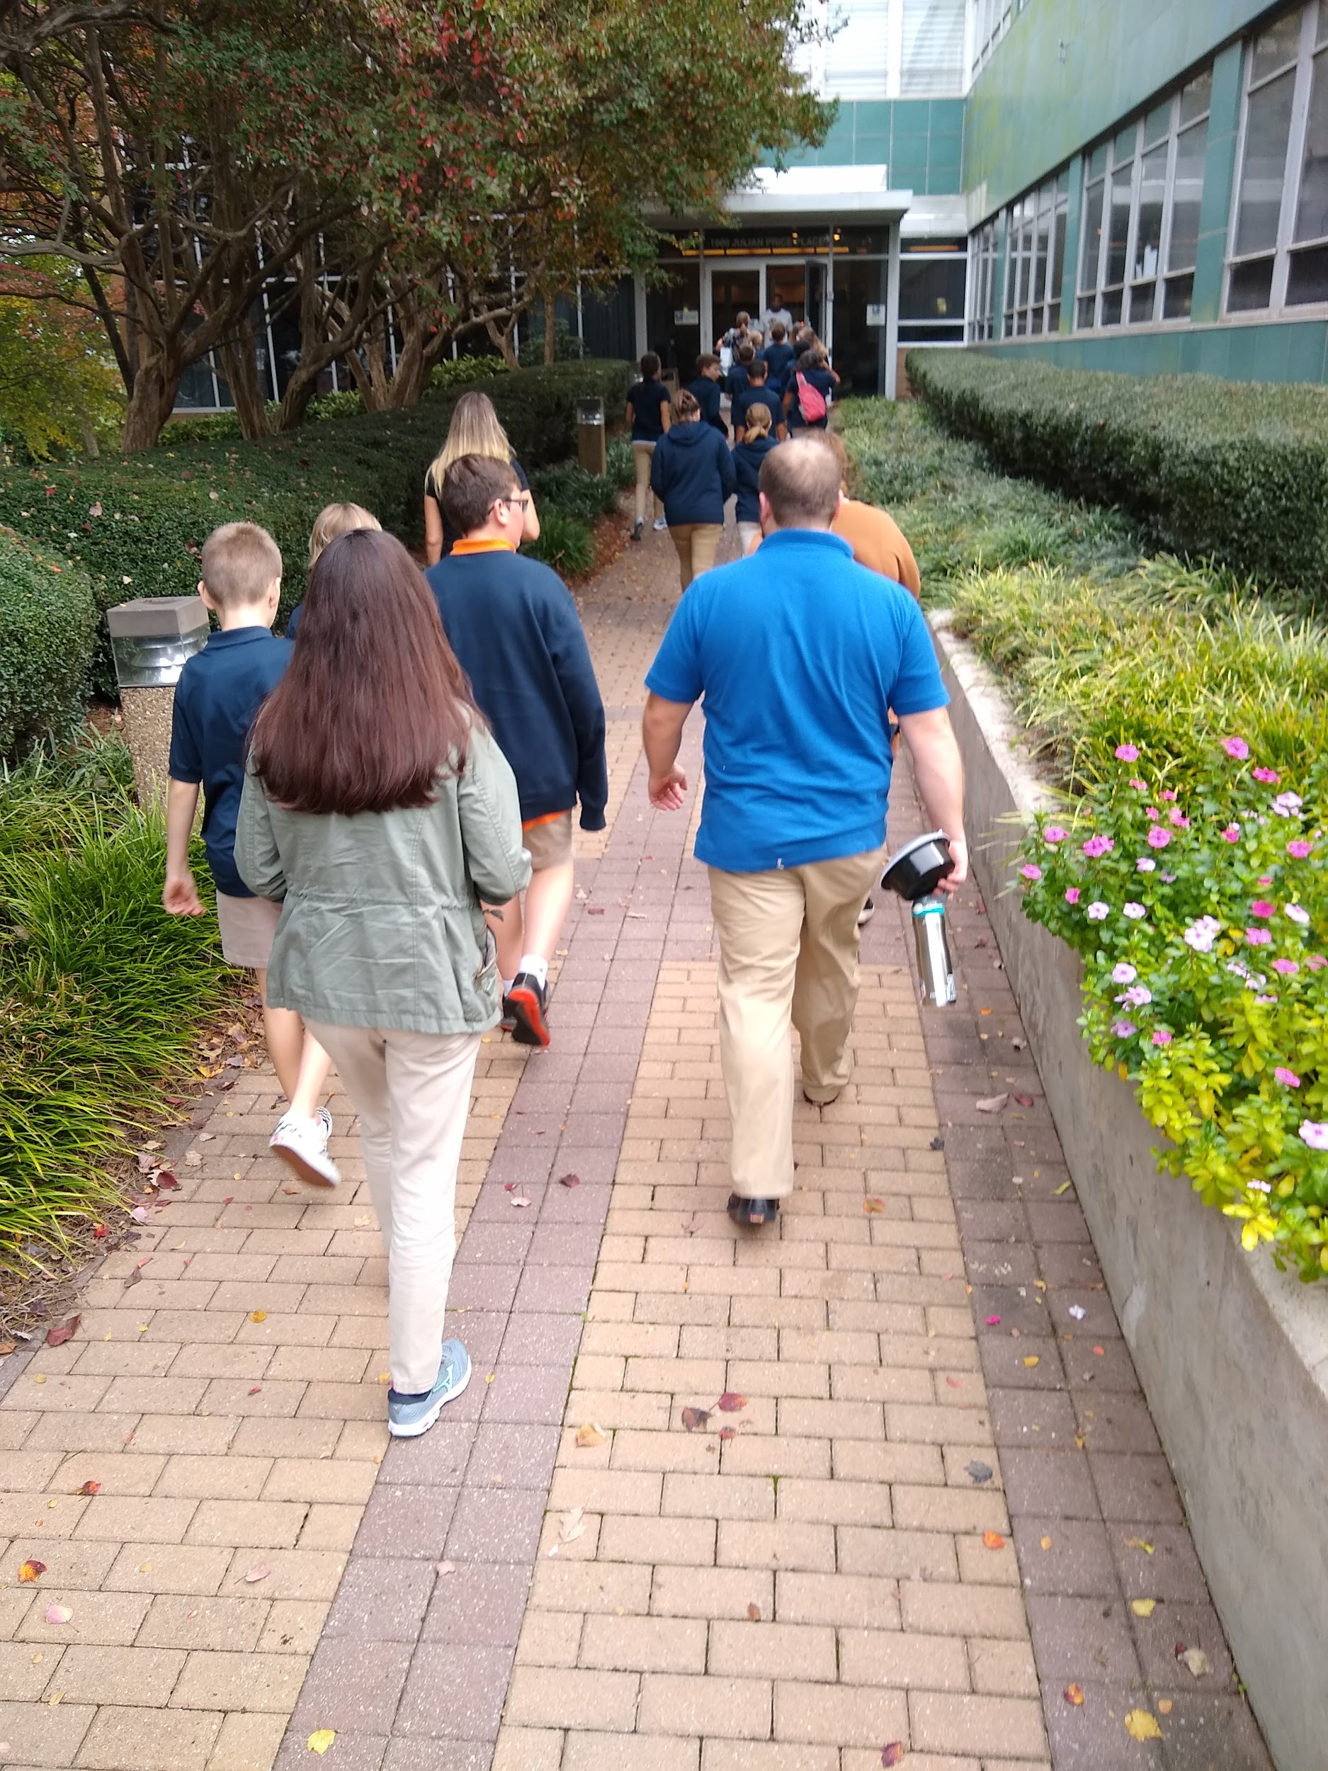
Launch: A visit to Entercom Charlotte

Slide 3
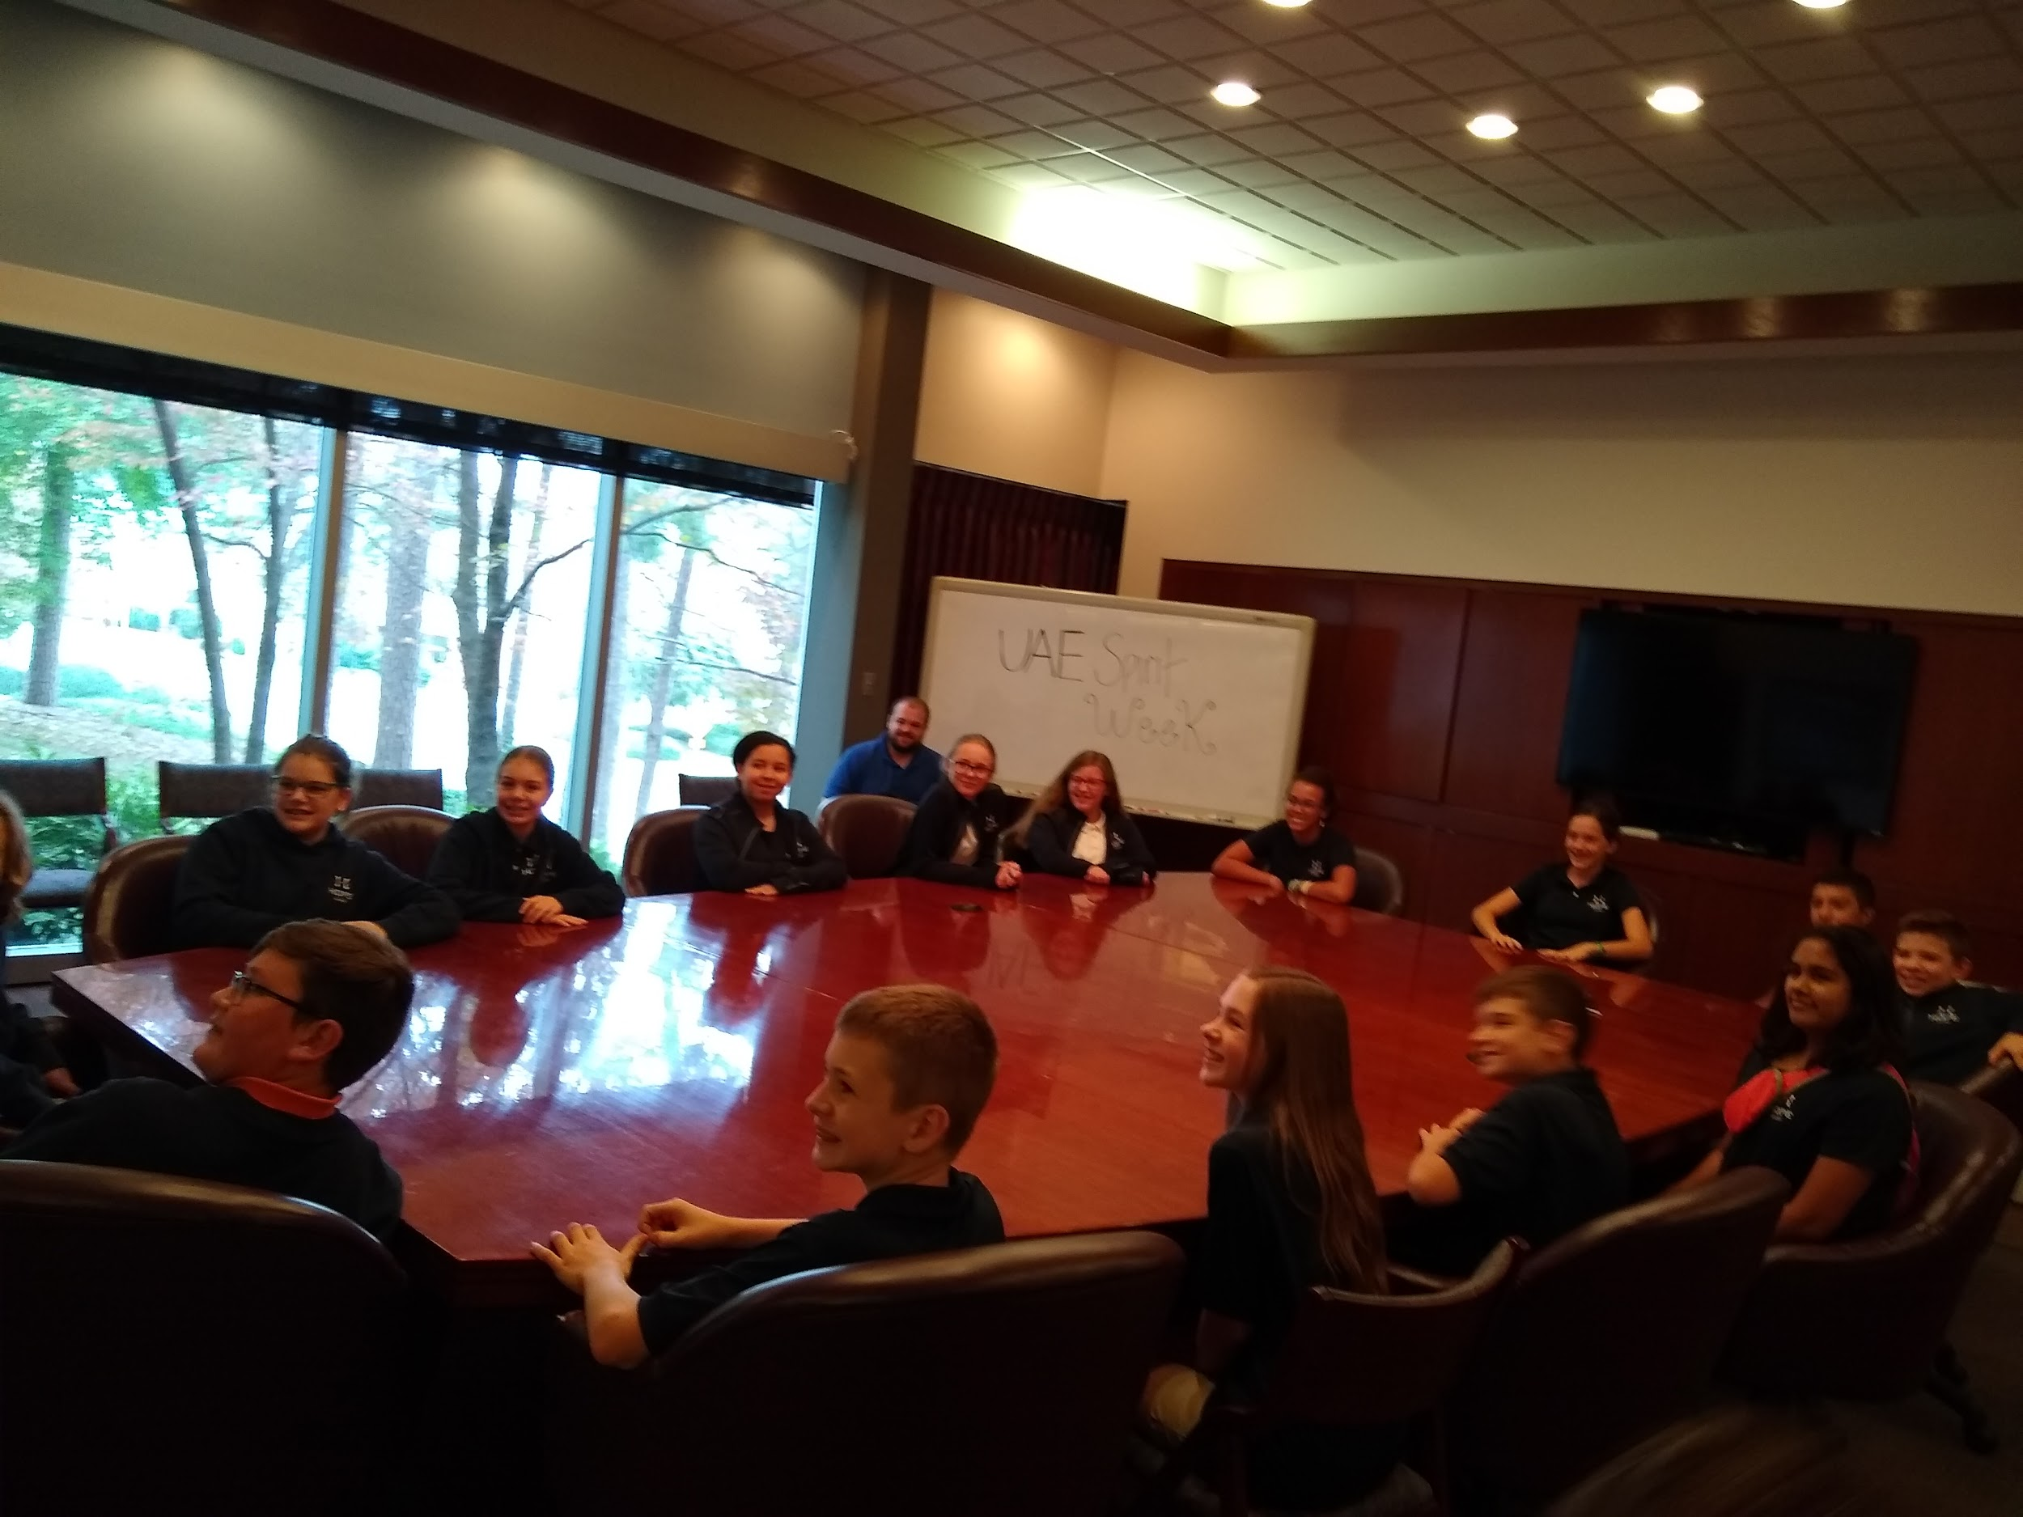
First stop: Conference Room for an intro to our tour. The excitement is building as students do not yet know what their project is!

Slide 4
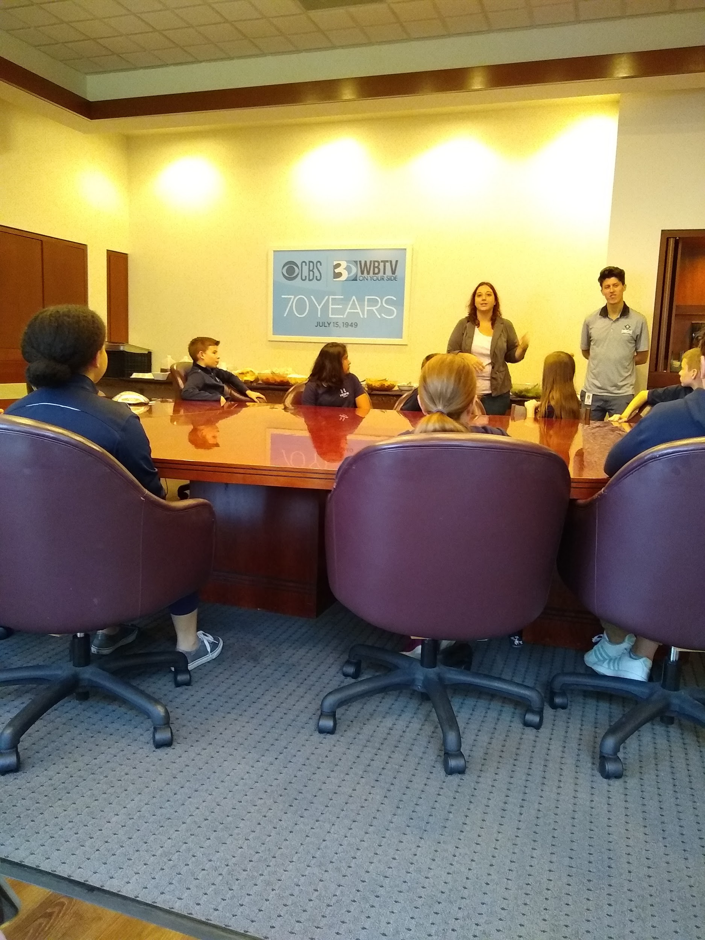

Slide 5
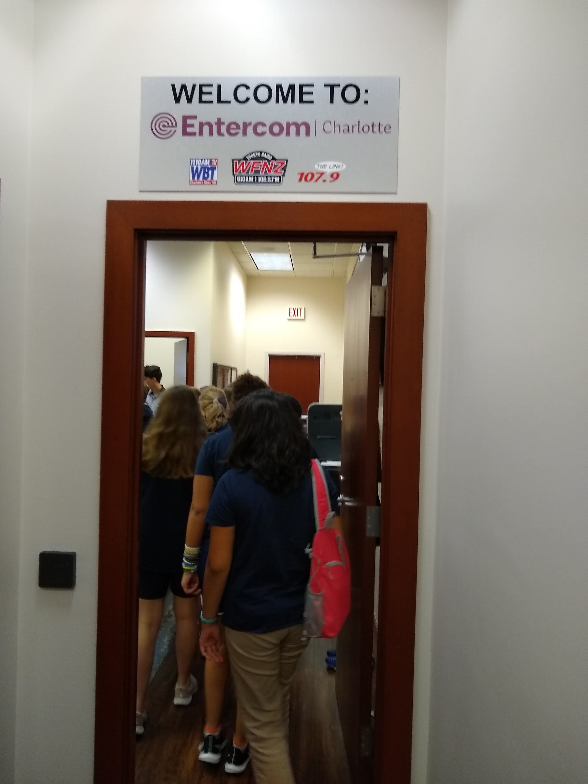
Start of our tour!

Slide 6
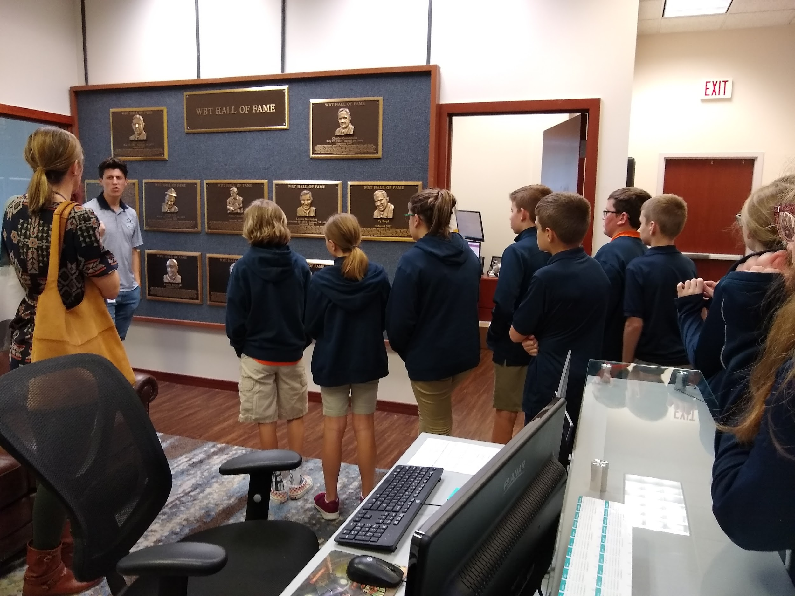

Slide 7
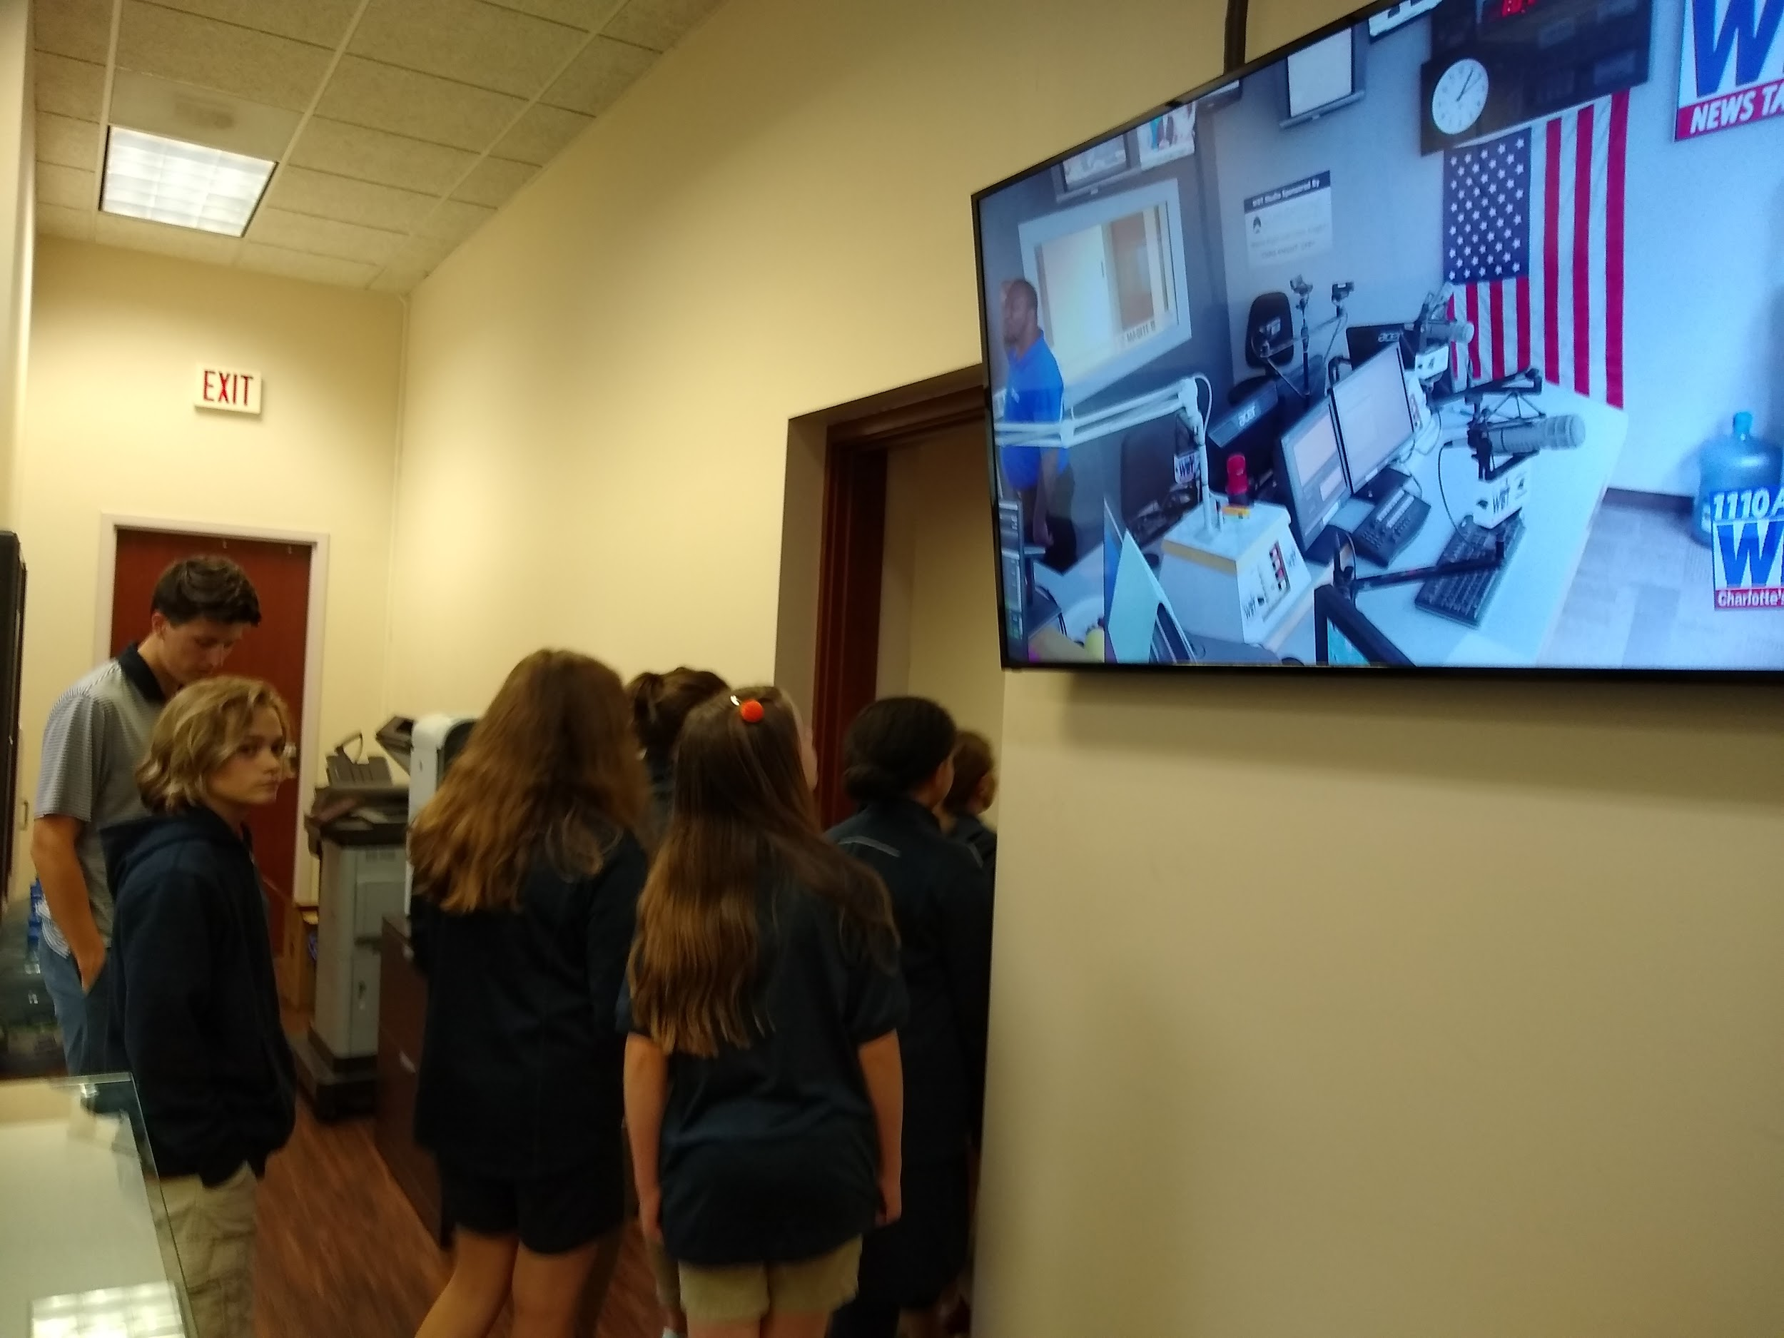

Slide 8
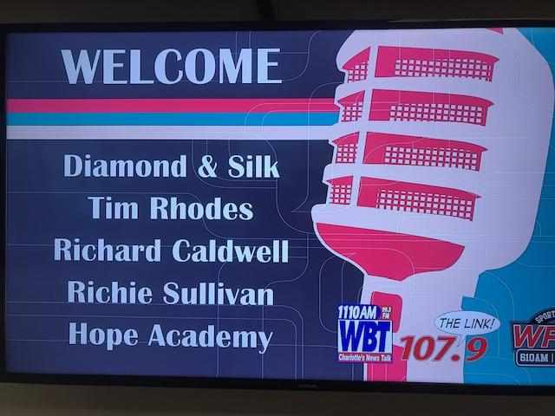

Slide 9
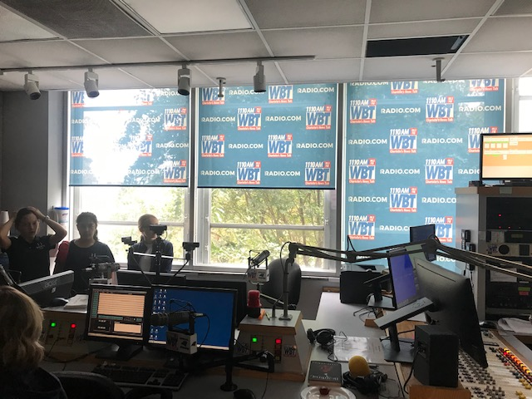

Slide 10
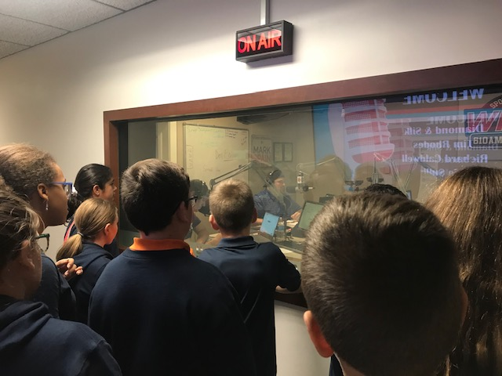
LIVE sports radio show!

Slide 11
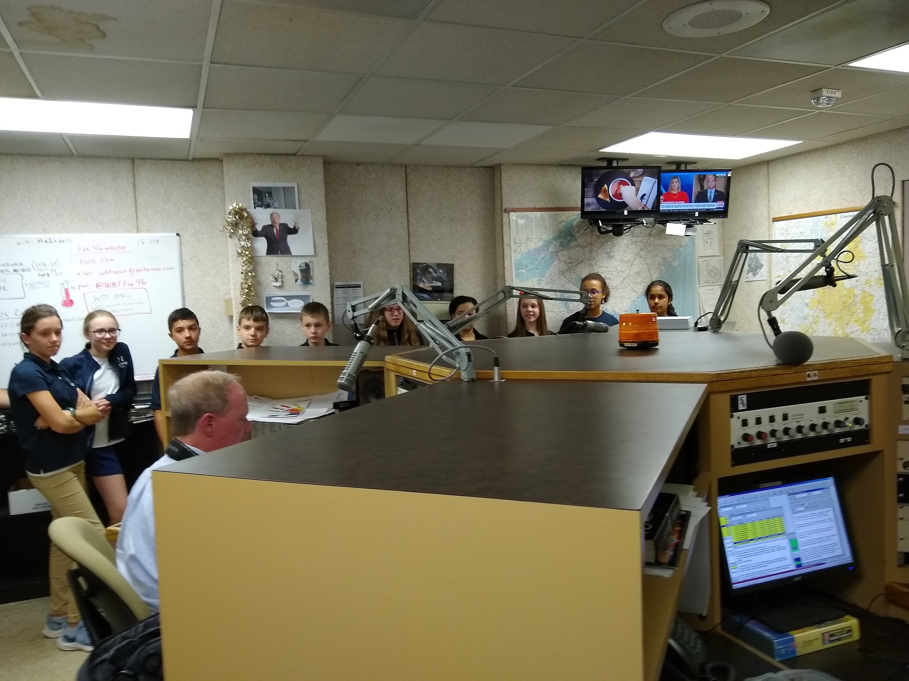
Weather, Traffic, and Breaking News Room

Slide 12
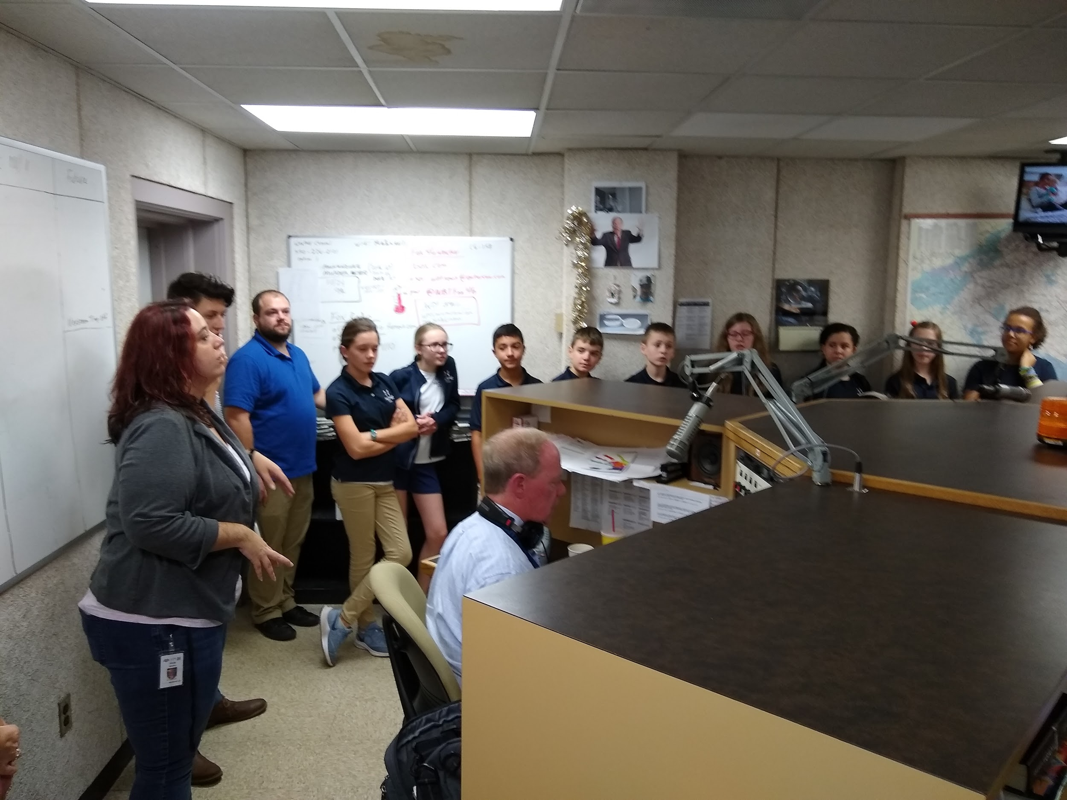

Slide 13
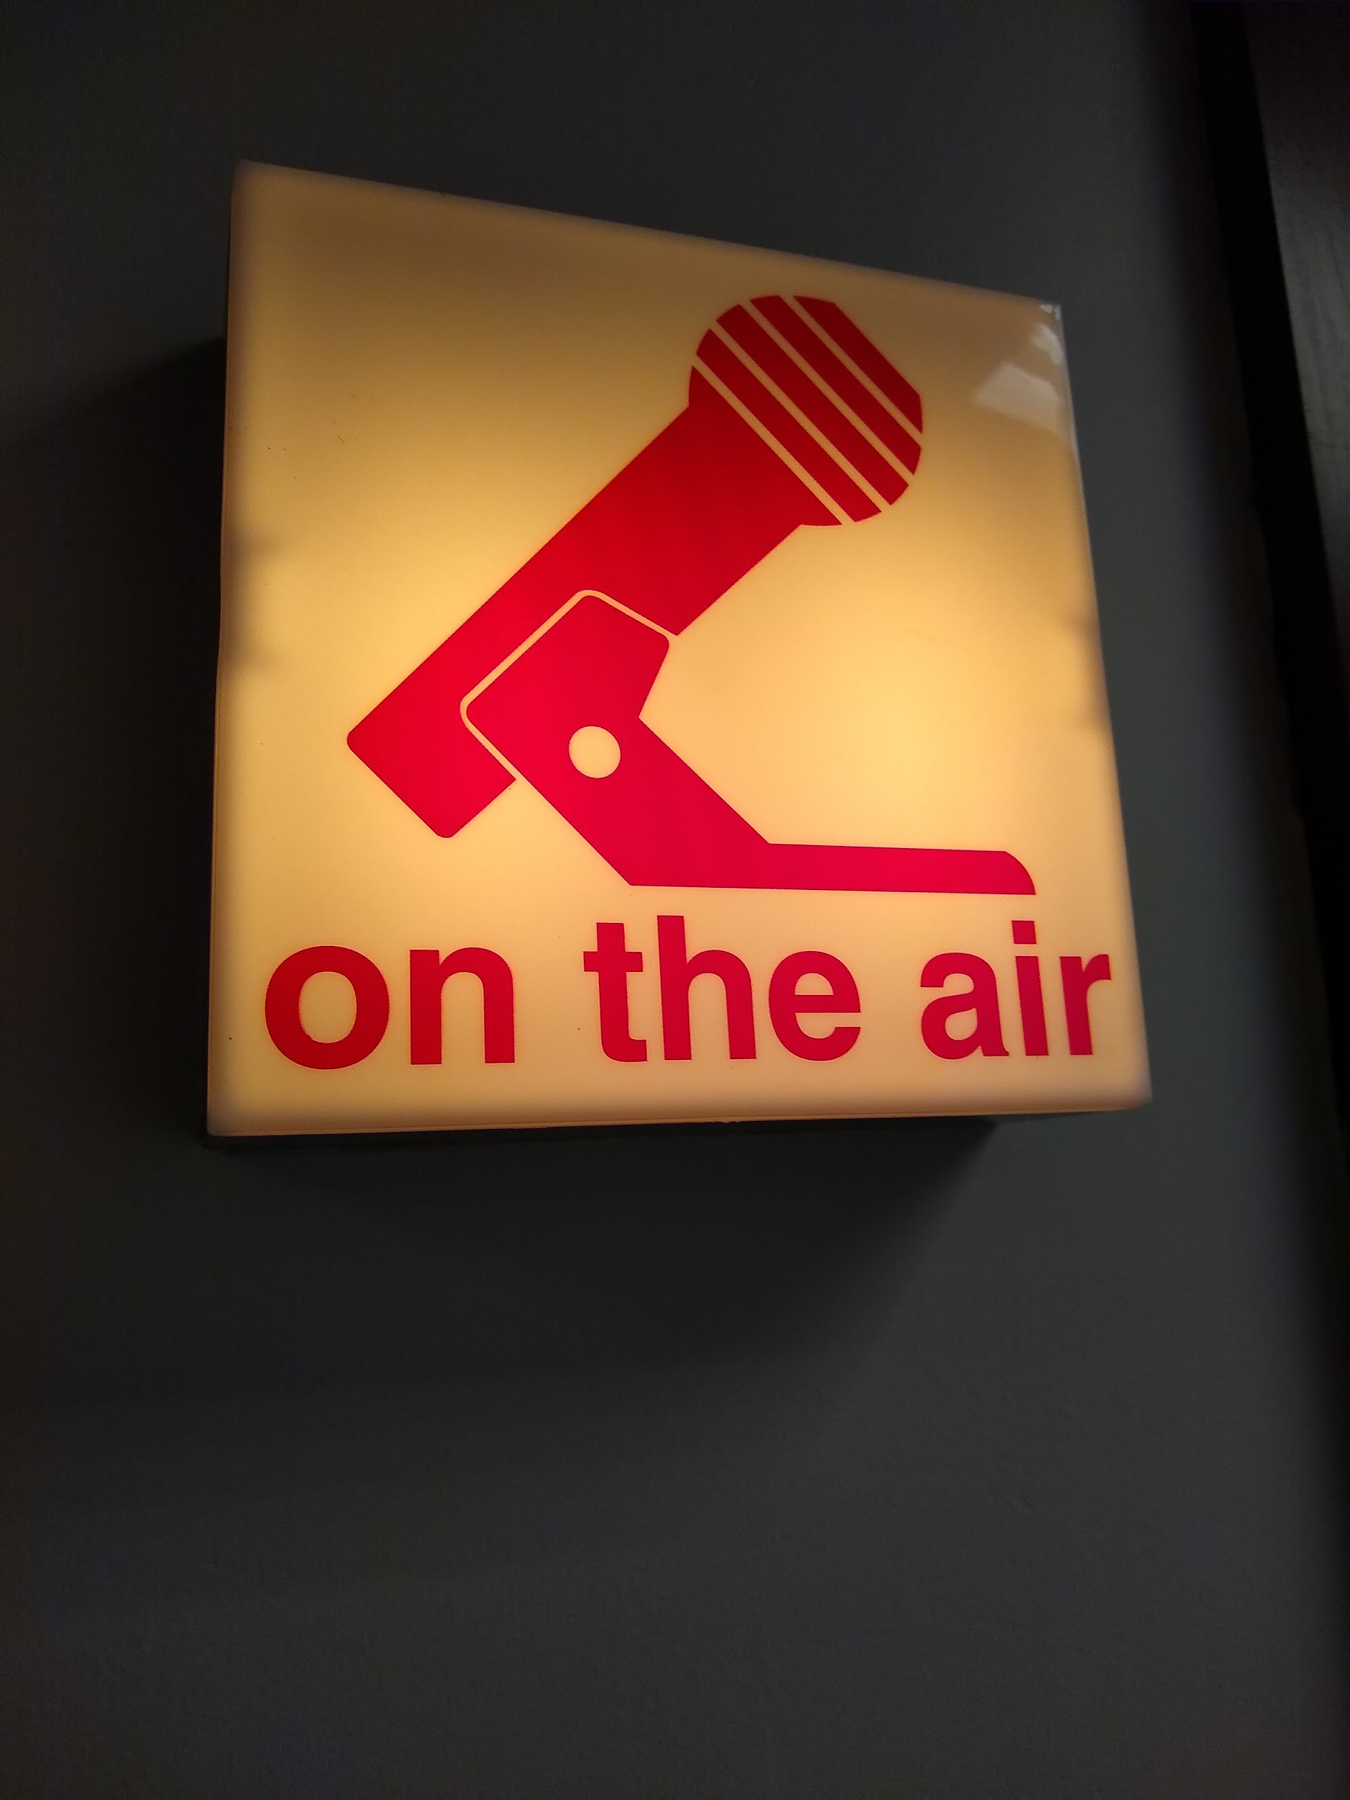

Slide 14
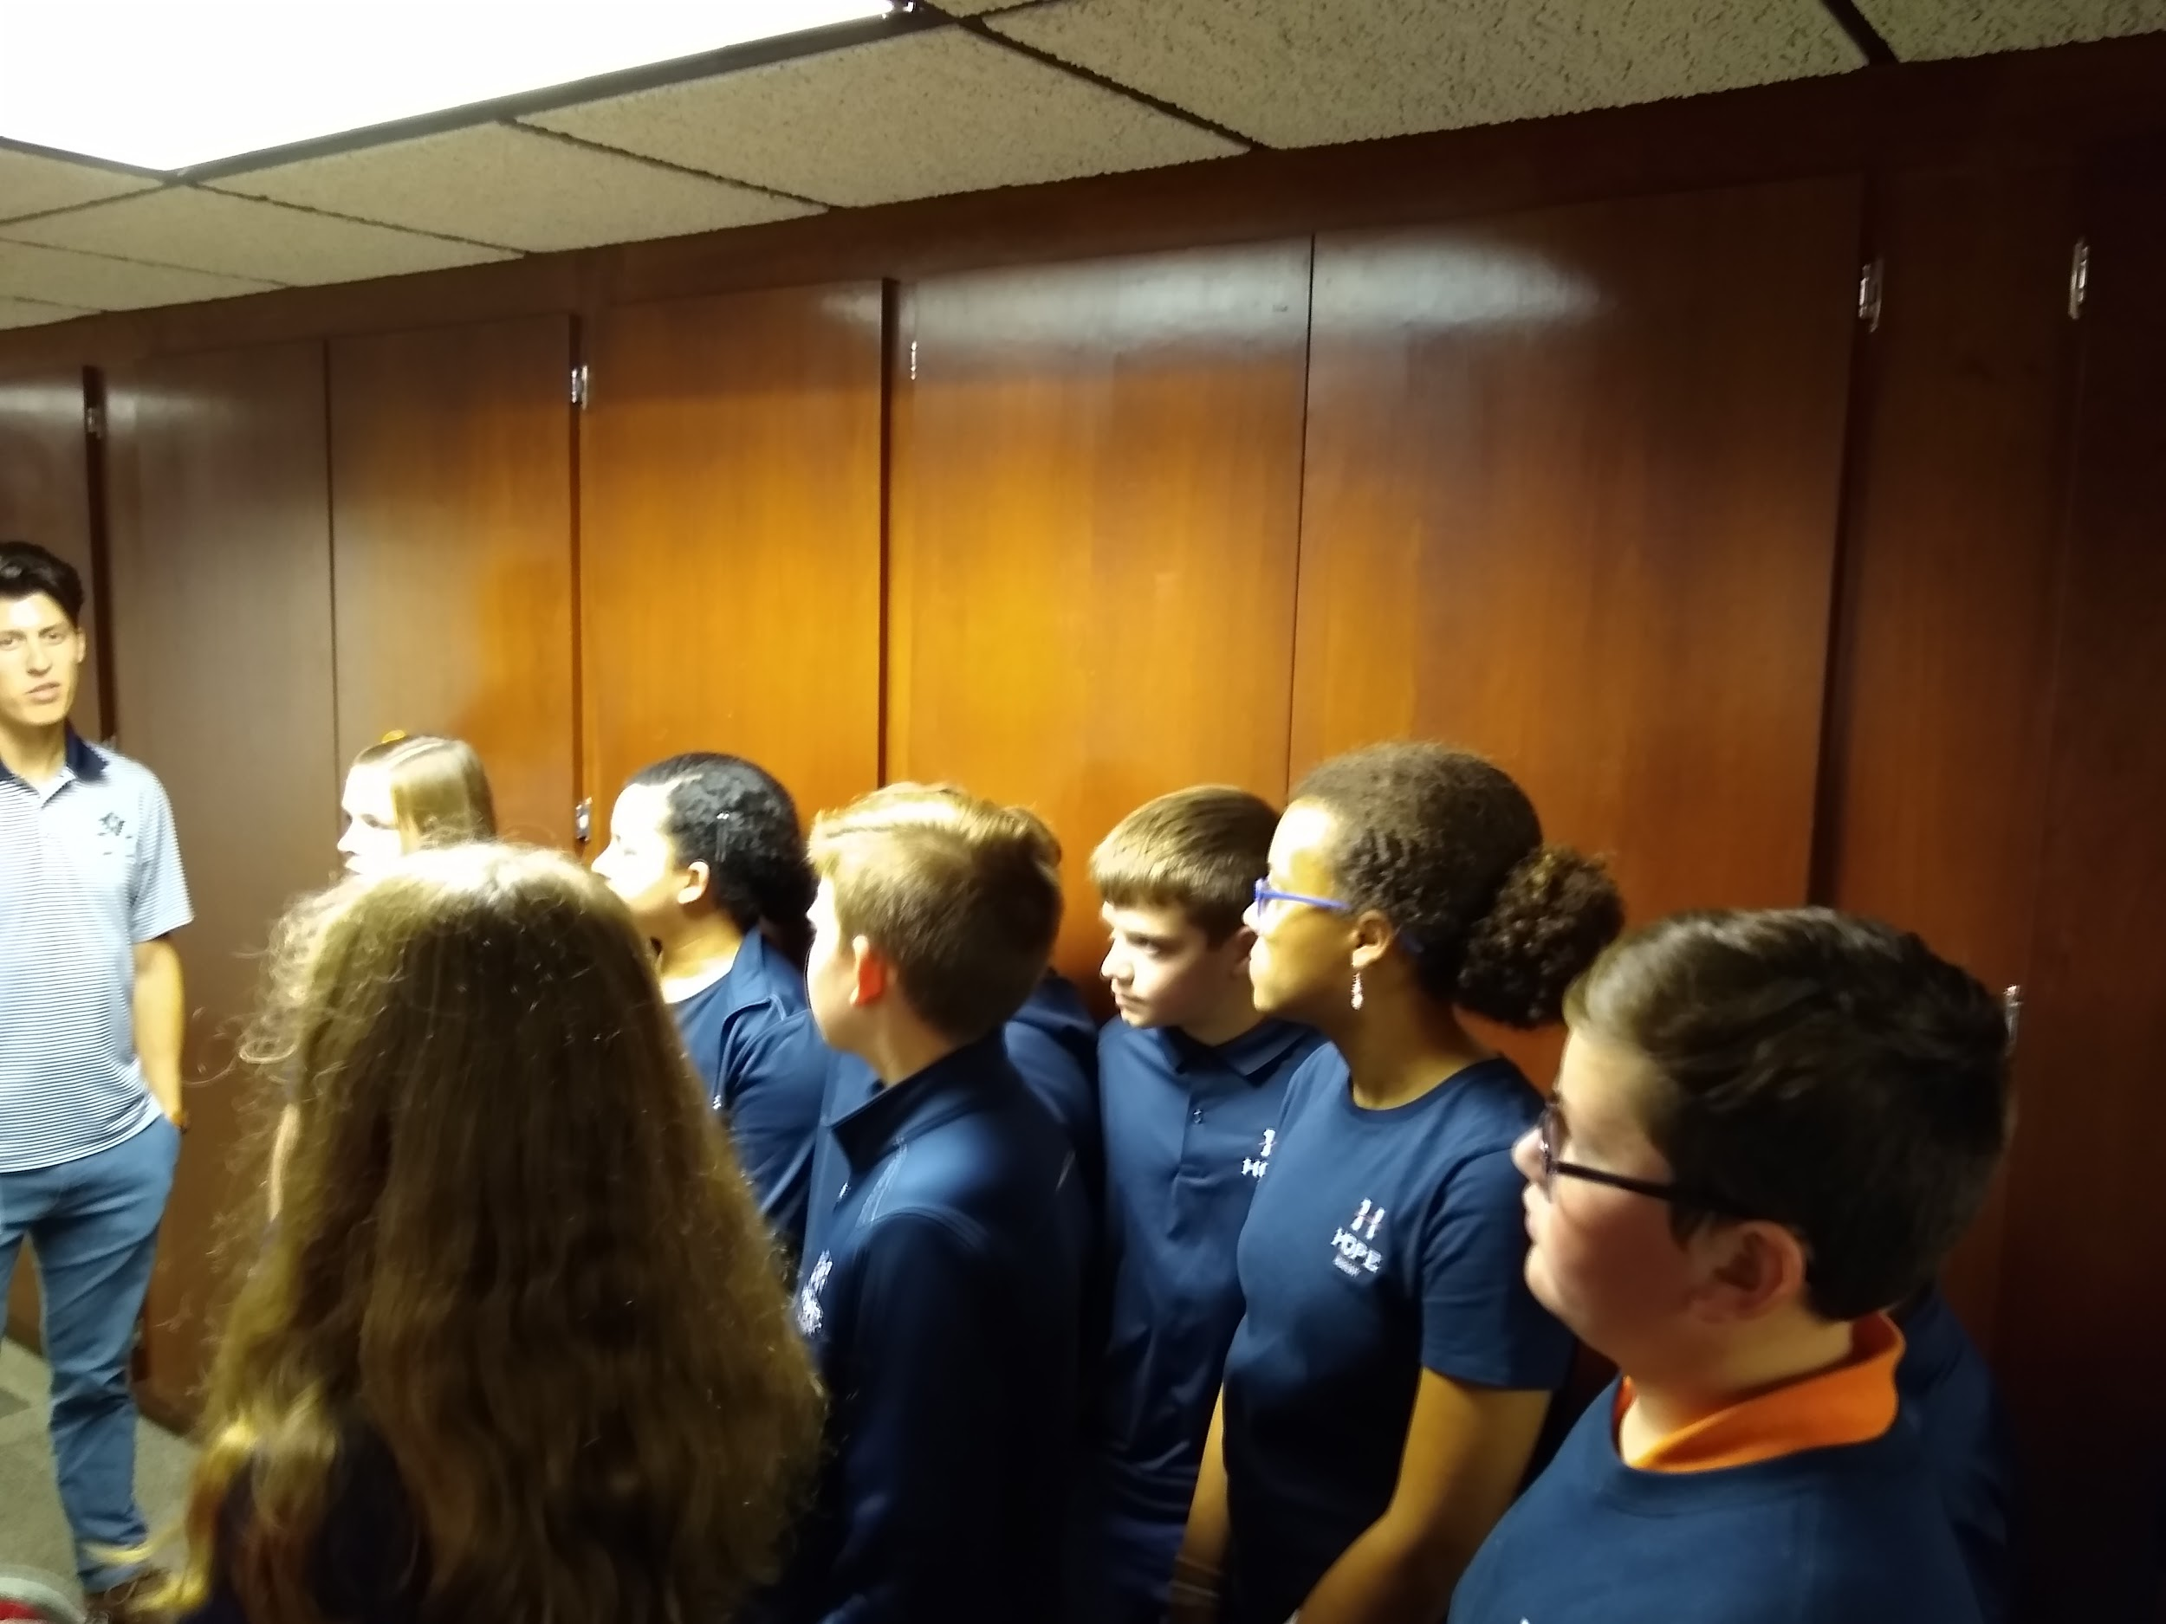

Slide 15
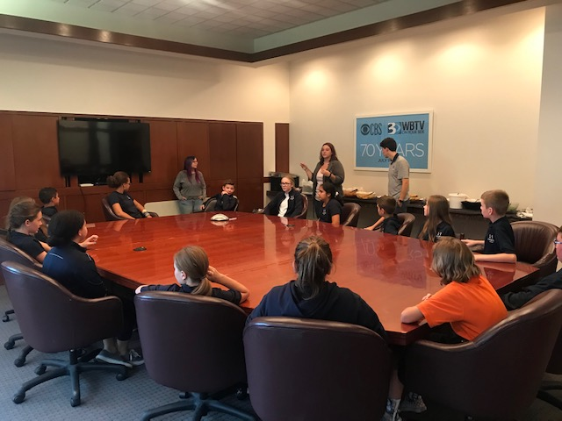
Back to the conference room to meet with the Digital Content Manager and find out what the project will be!

Slide 16
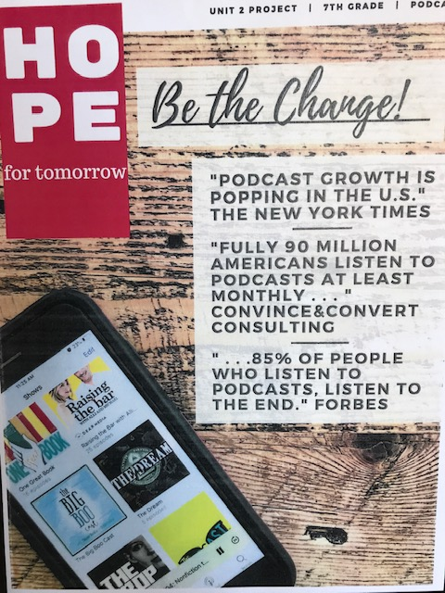
Project
Announced!

Slide 17
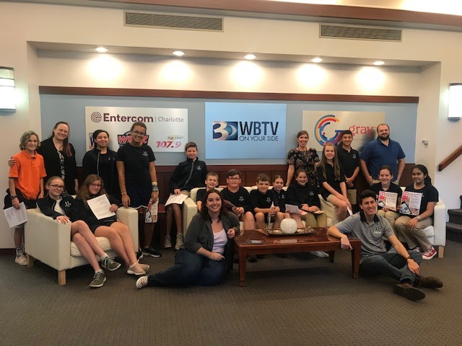

Slide 18
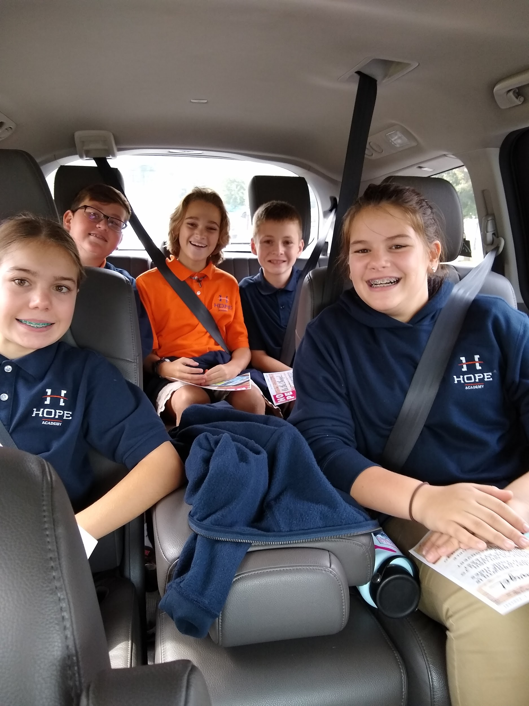
Carpooling back to school to brainstorm and listen to a recorded episode made by their teachers!

Slide 19
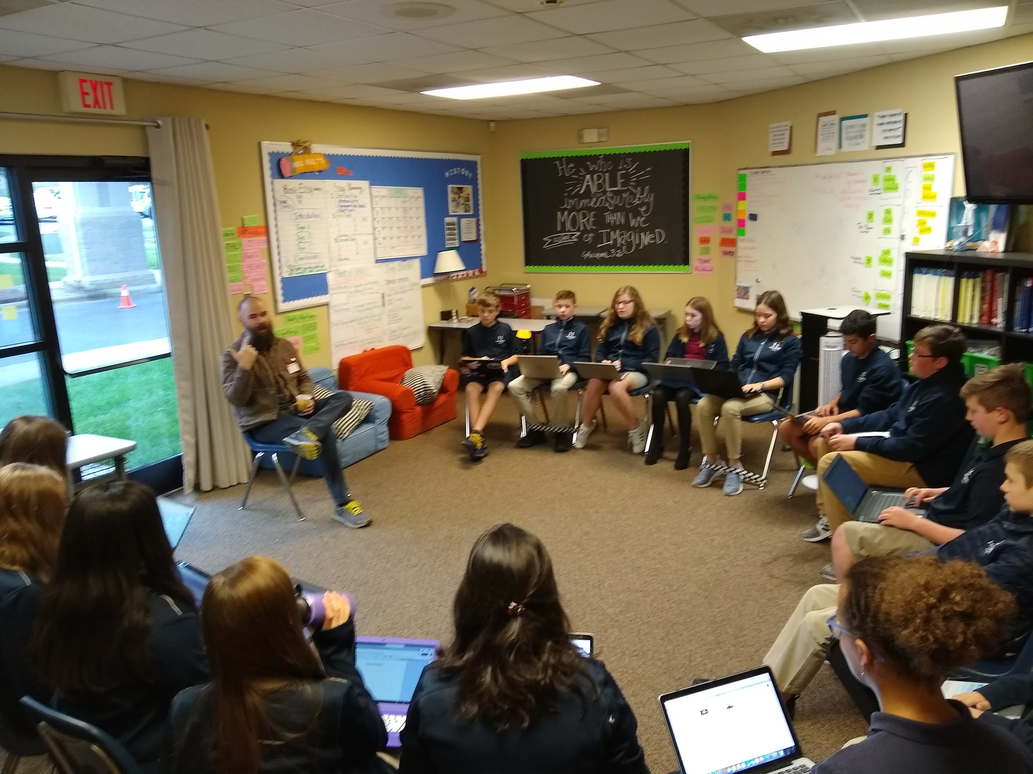
Local podcaster, Michael Yarborough, came to offer advice, support, and guidance. He answered all of our many questions and was super helpful!

Slide 20
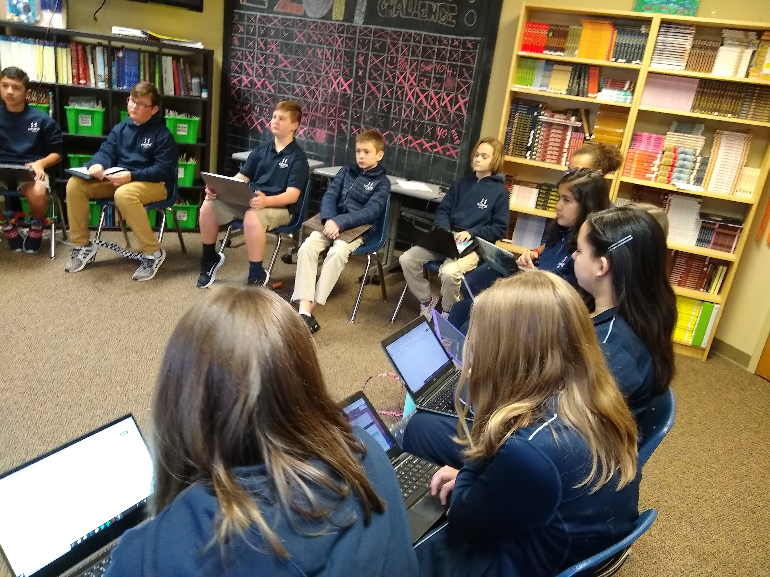

Slide 21
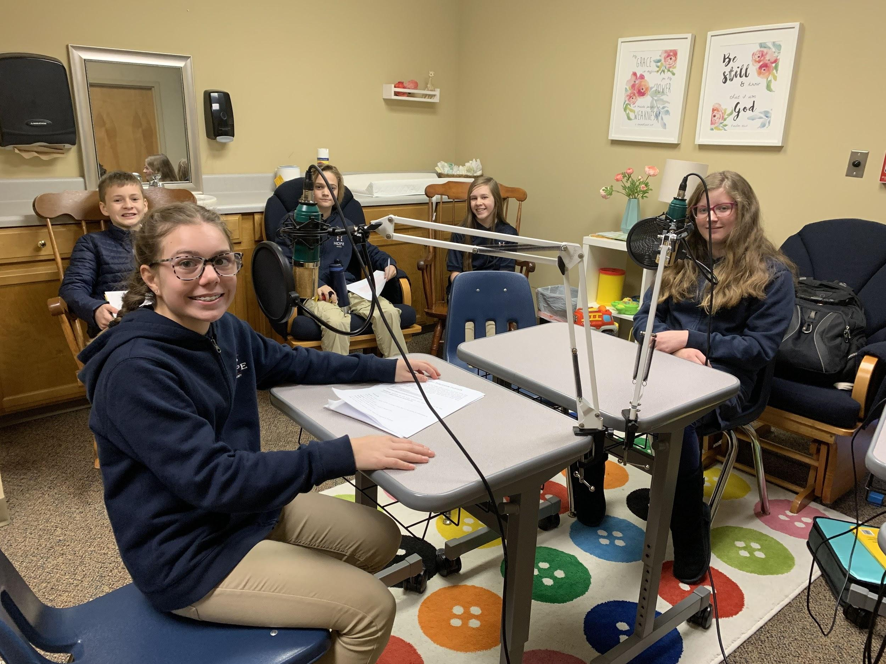
Recording Day!!! Students used the program Audacity to record their segments. Huge thanks to Mr. Levinson for the equipment and lessons on how to operate the program!

Slide 22
SIXTEEN VOICES
SEVEN TOPICS
FOUR TEACHERS
FIVE CLASSES
ONE QUESTION

Slide 23
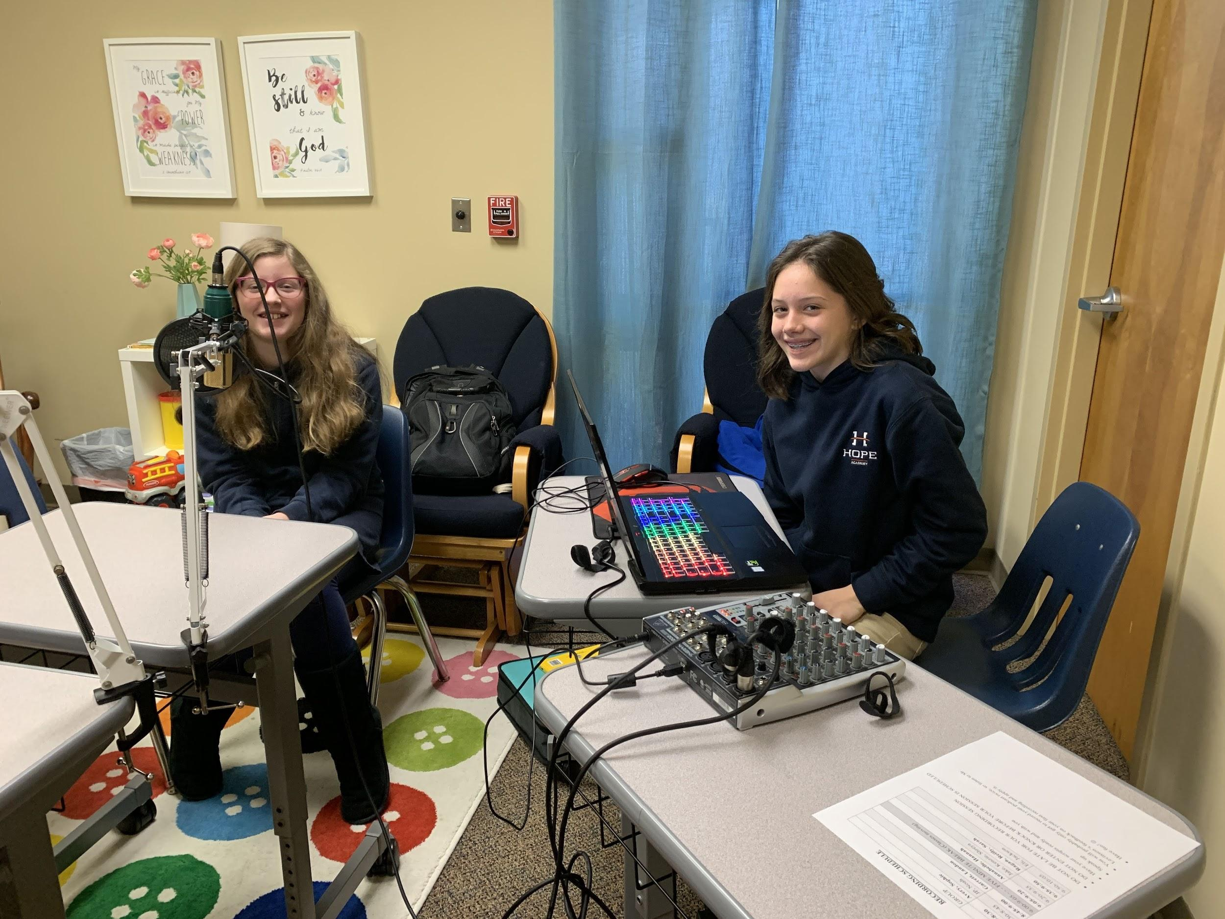
The
Charlotte
Housing
Crisis

Slide 24
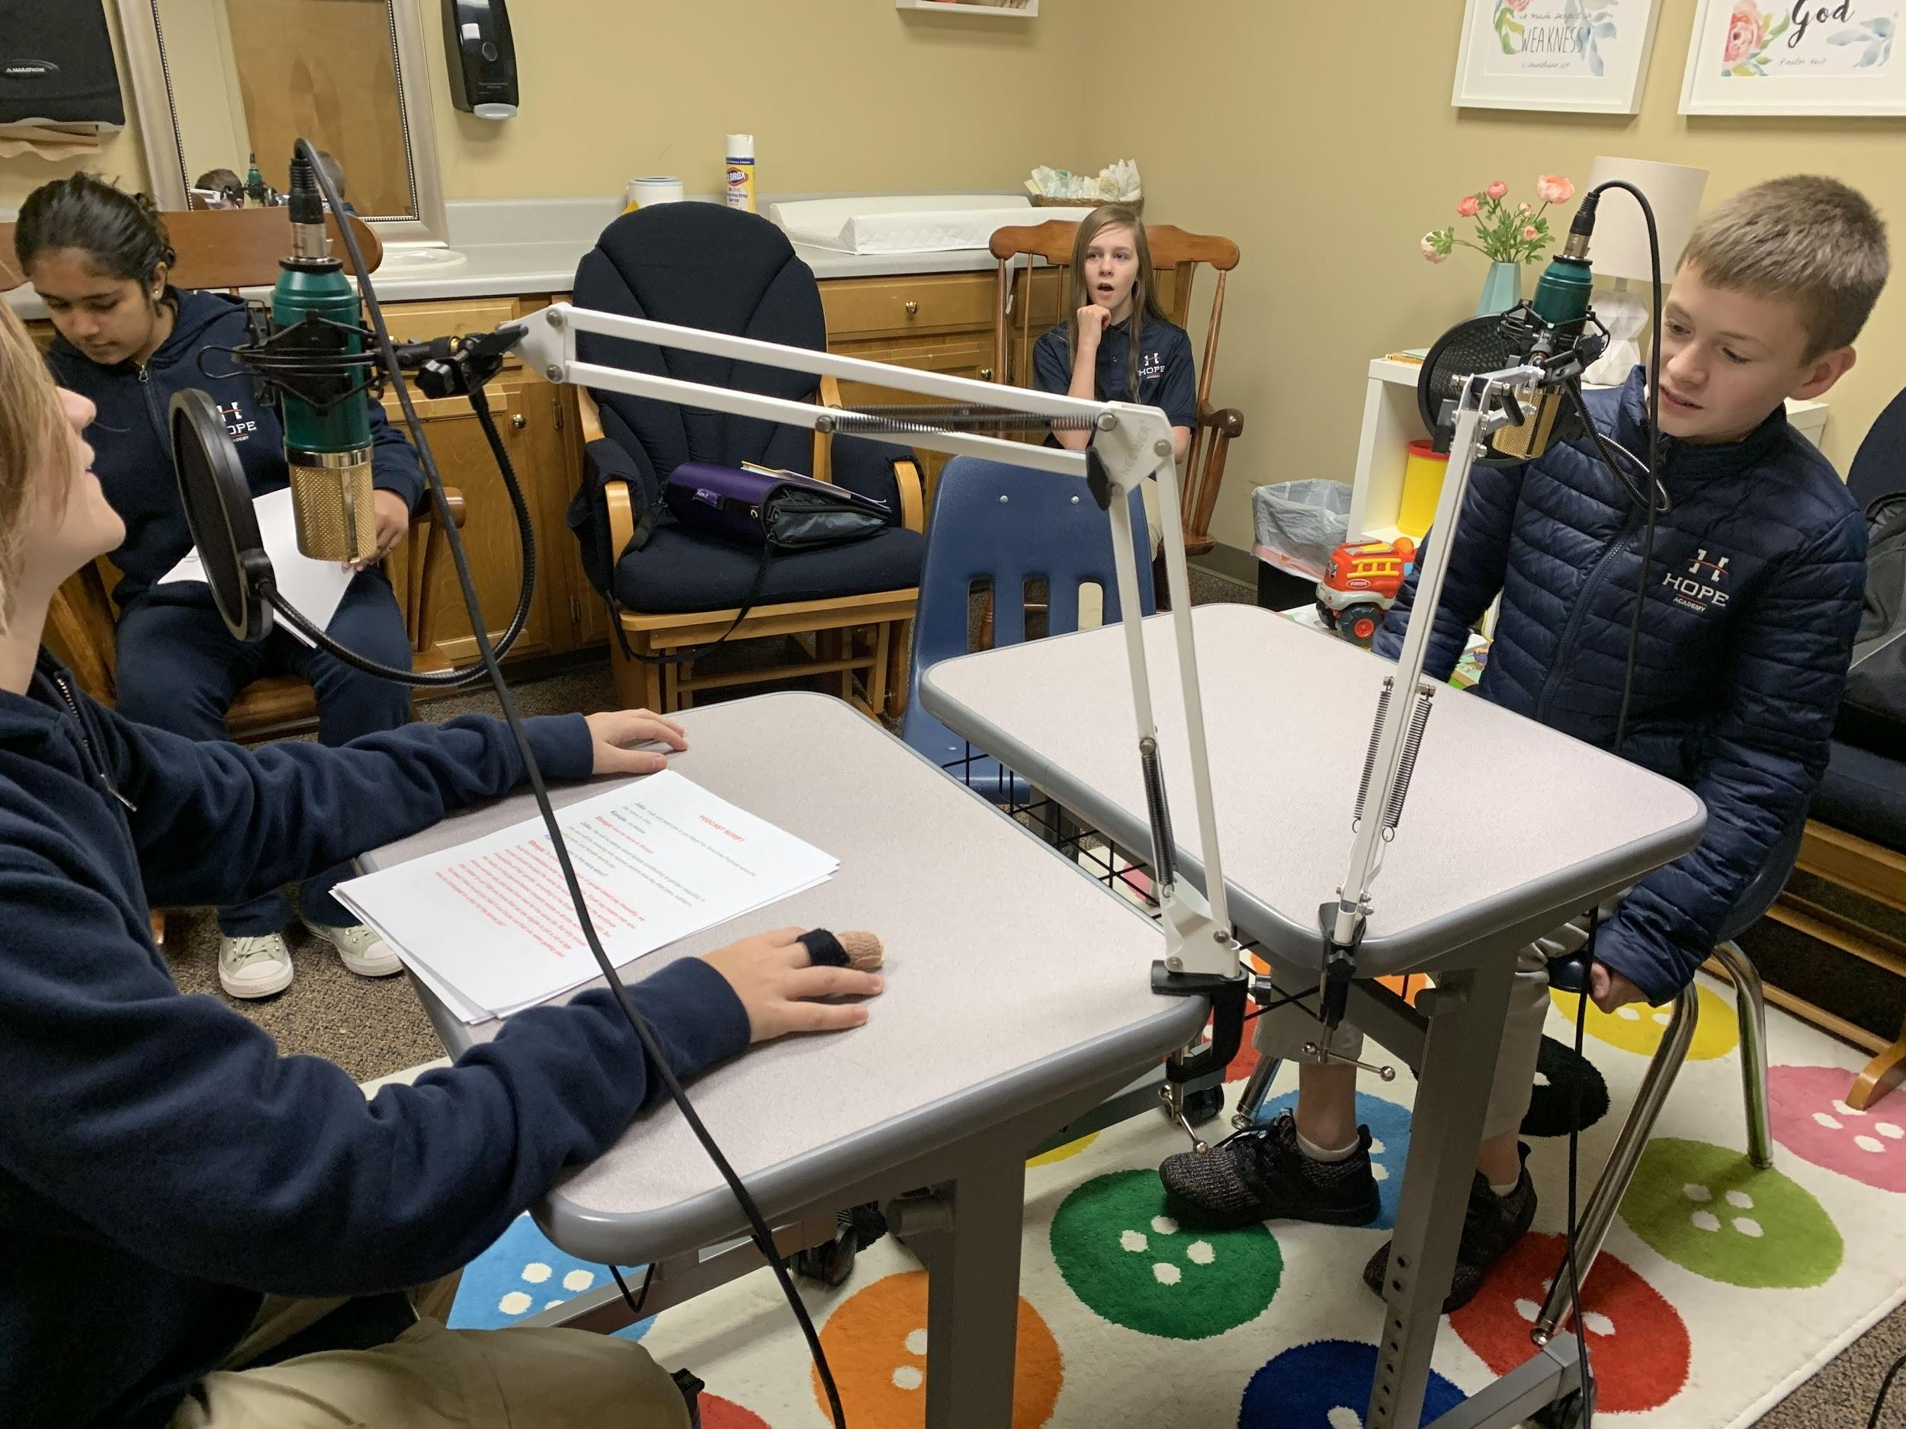
Foster
Care

Slide 25
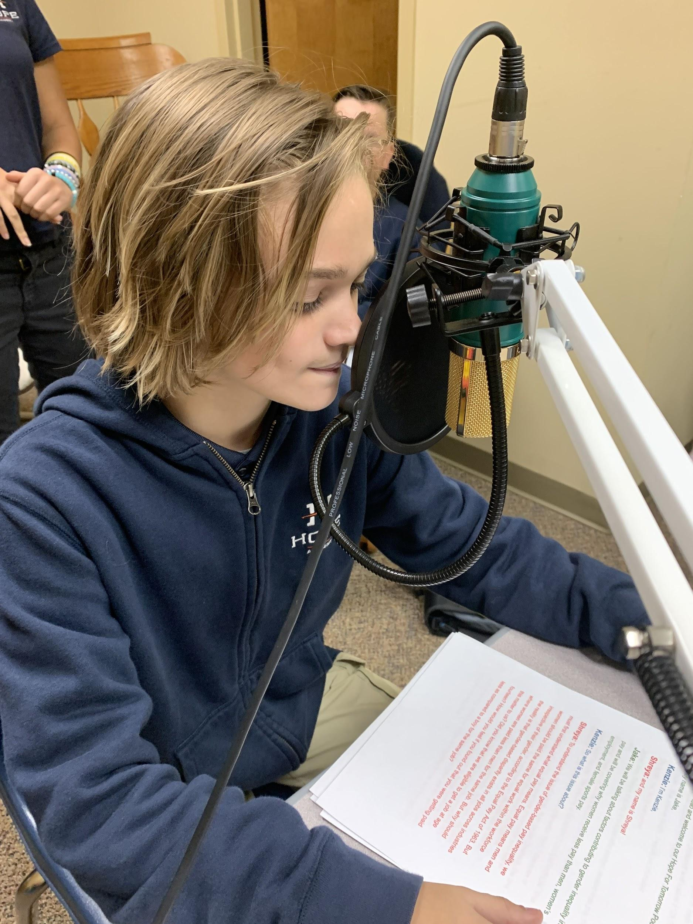
Future
podcaster!

Slide 26
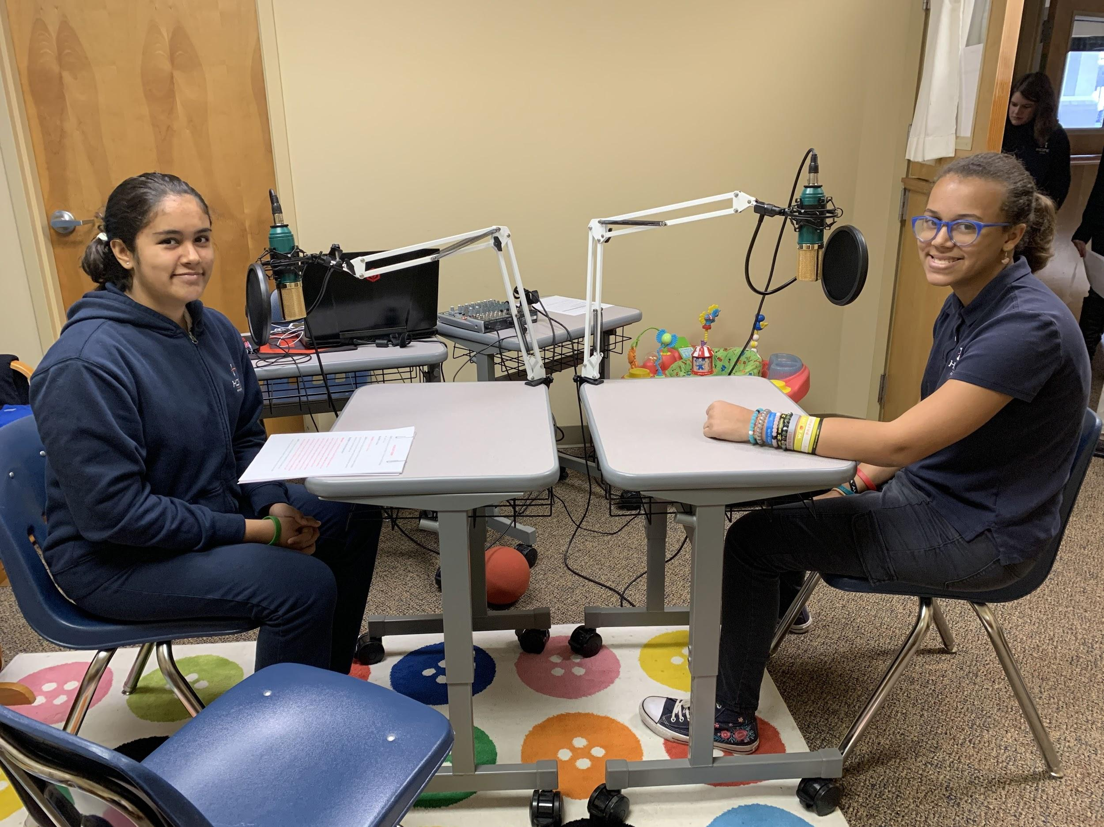
Gender Pay Inequality

Slide 27
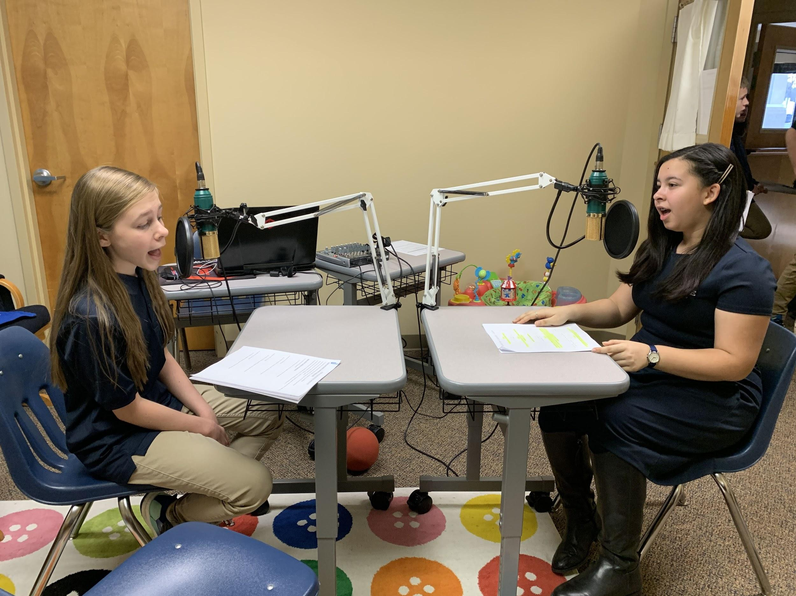
Declining
Bird
Population

Slide 28
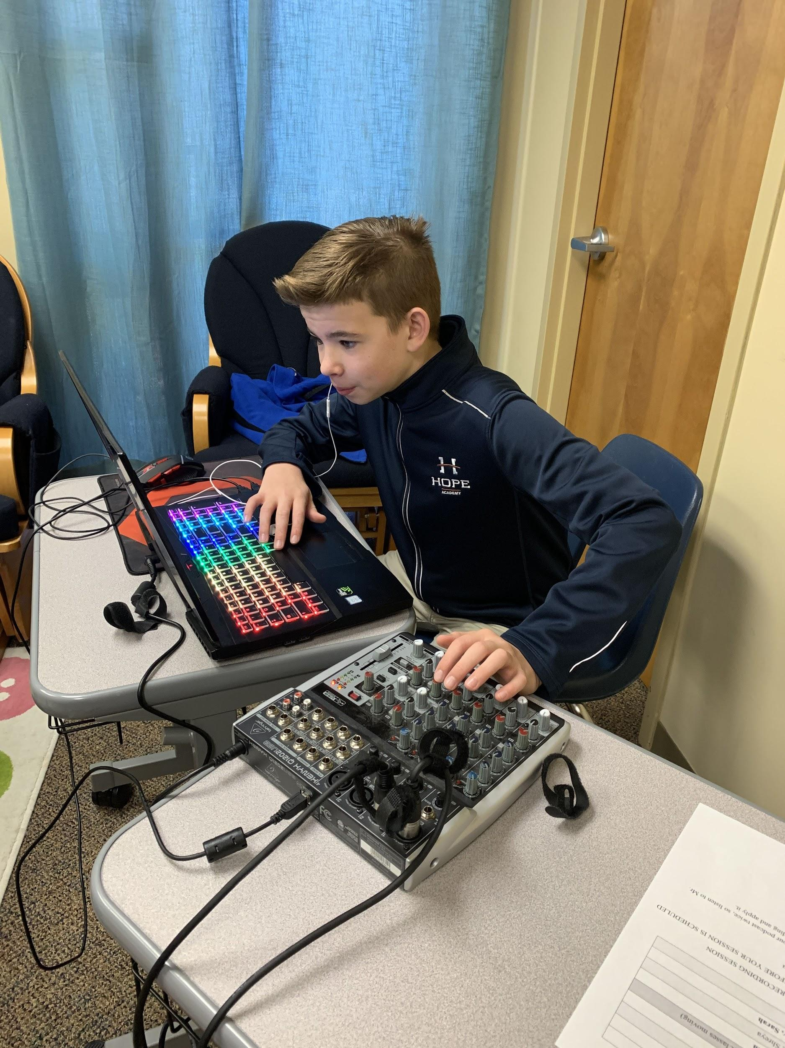
Plastic
Pollution

Slide 29
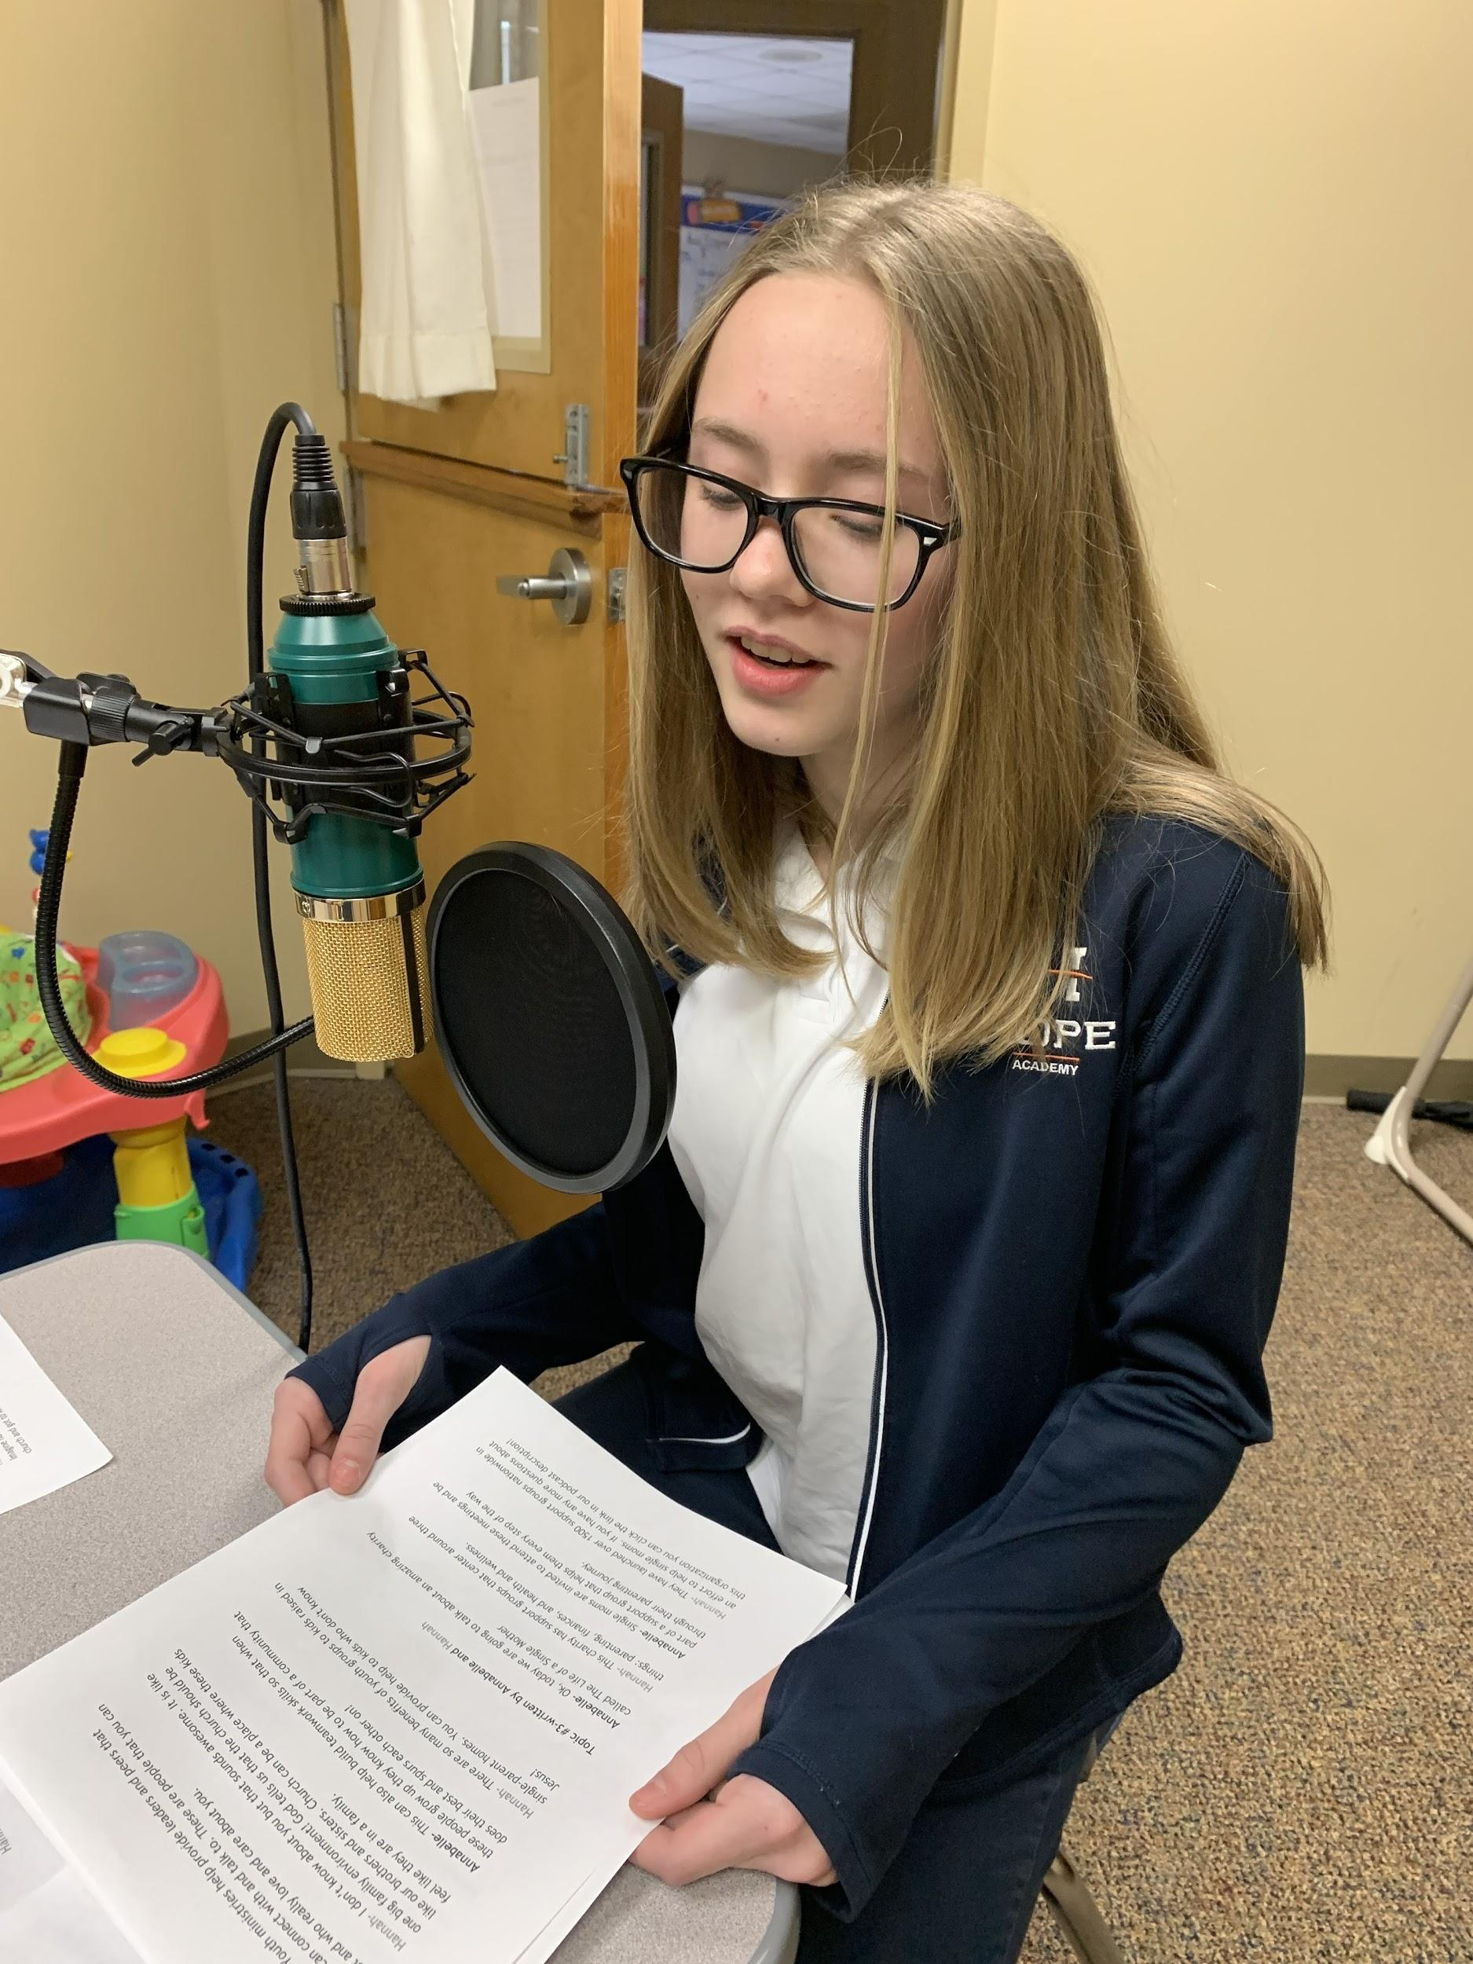
Children
from
Single-parent
Families

Slide 30
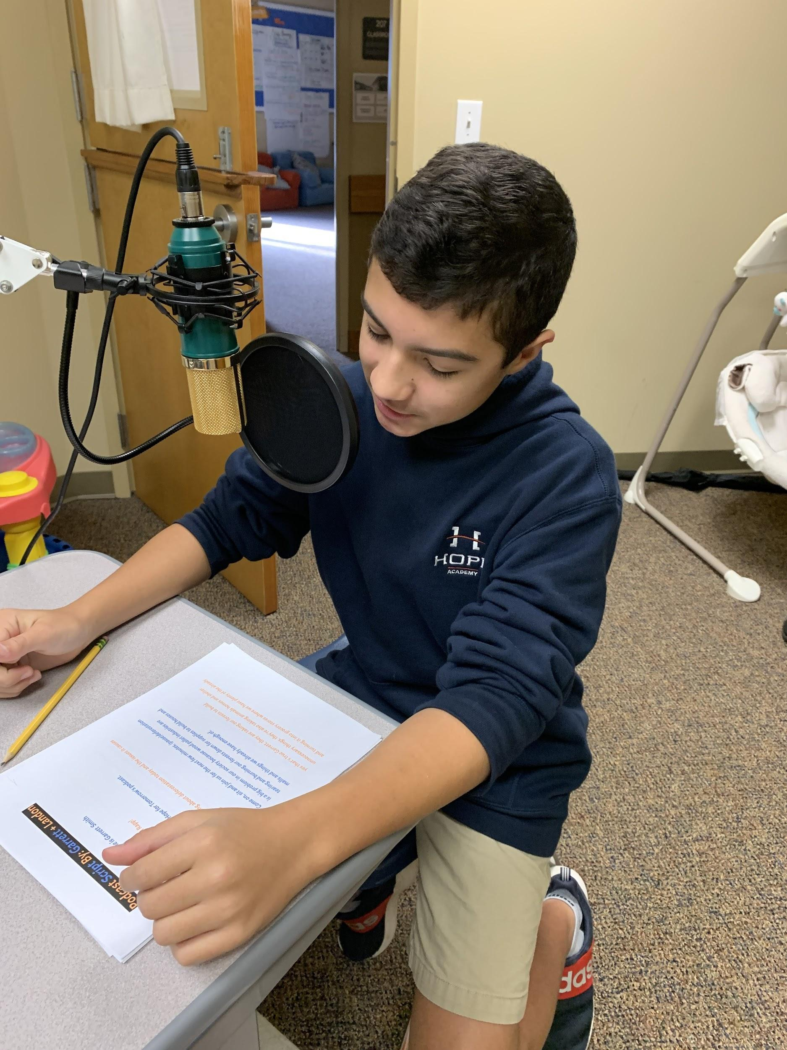
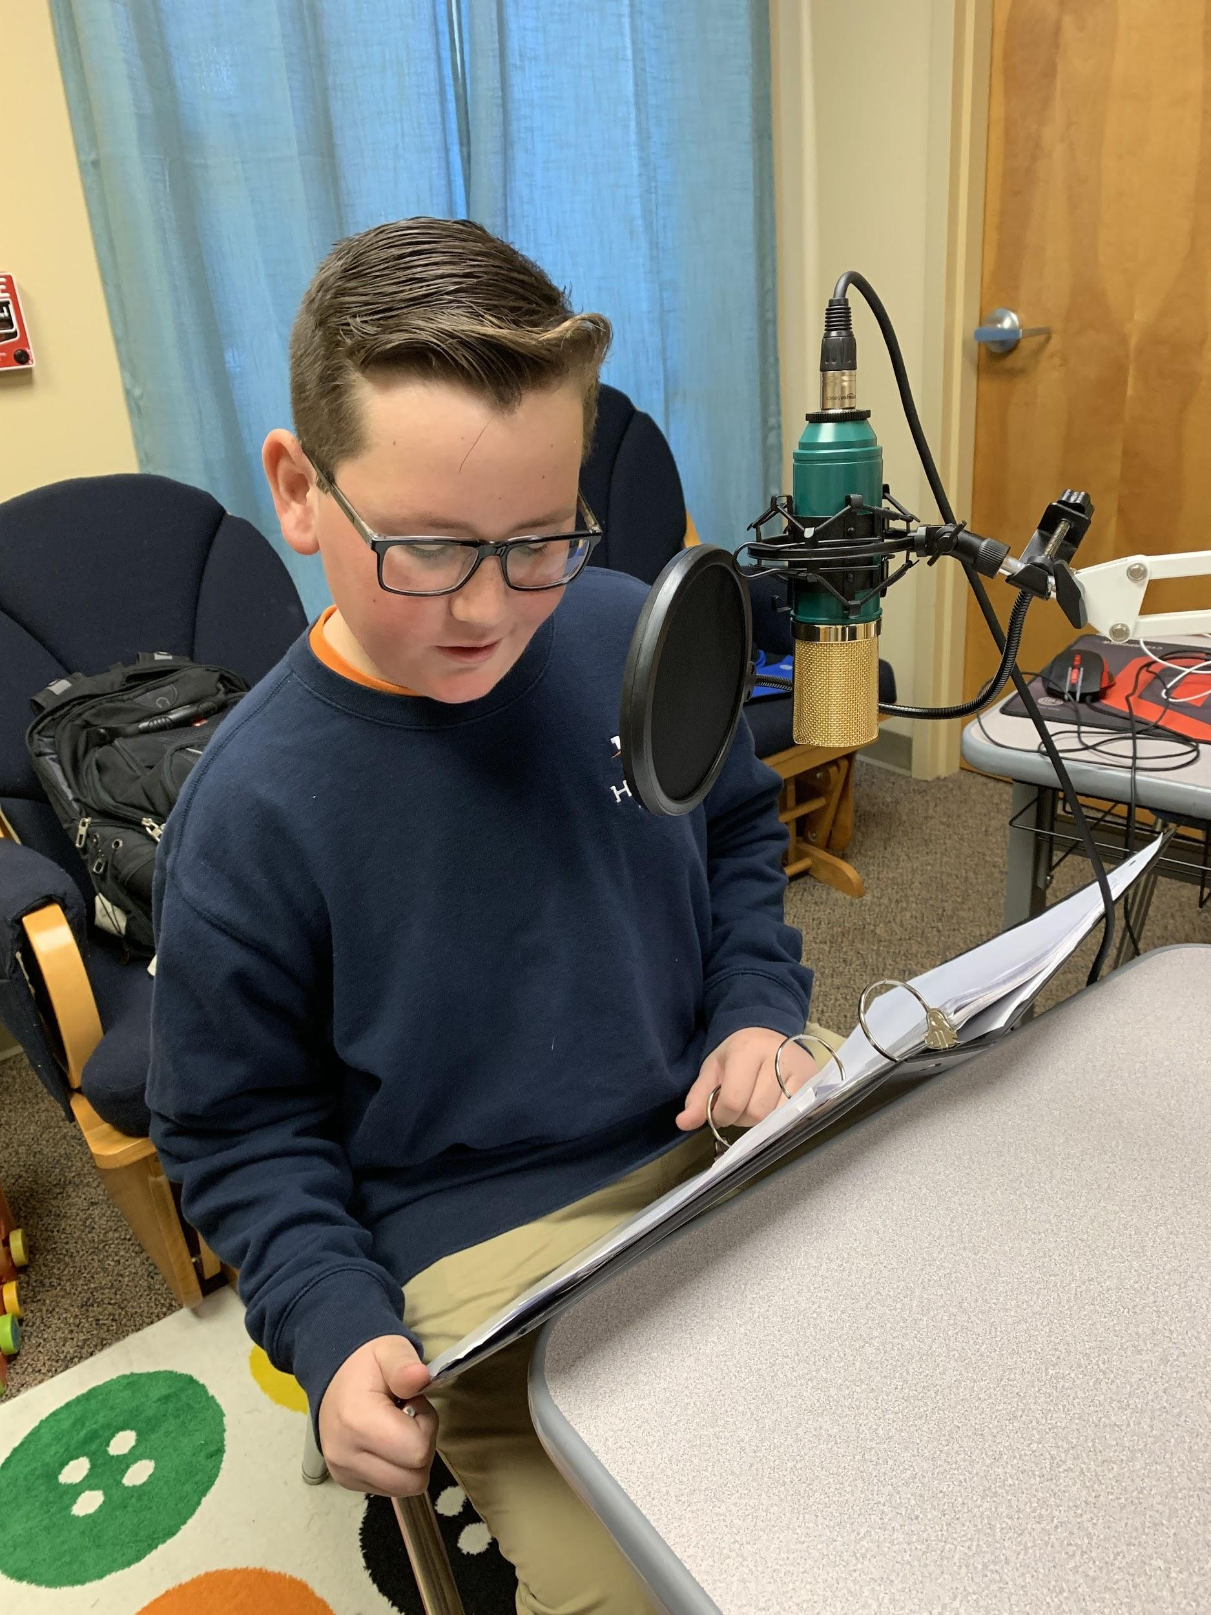
Deforestation

Slide 31
Stay tuned . . . PODCAST episodes will launch January 2020
hopek12.com/hope-for-tomorrow
Special thanks to: Carpool Drivers, Entercom Charlotte, Michael Yarborough, Mrs. Pacetti (English/project lead), Miss Peatross (History/editor), Linda Harris (PBL), Mr. Levinson (Science/equipment), Ragan Coan (slideshow), Hannah Ballew (banner), and Audacity.

